Slide 1
Project Presentation
Mid evals
TEAM P<1
Arnav Deshmukh
Nidhish Jain
Nilavra ghosh

Slide 2

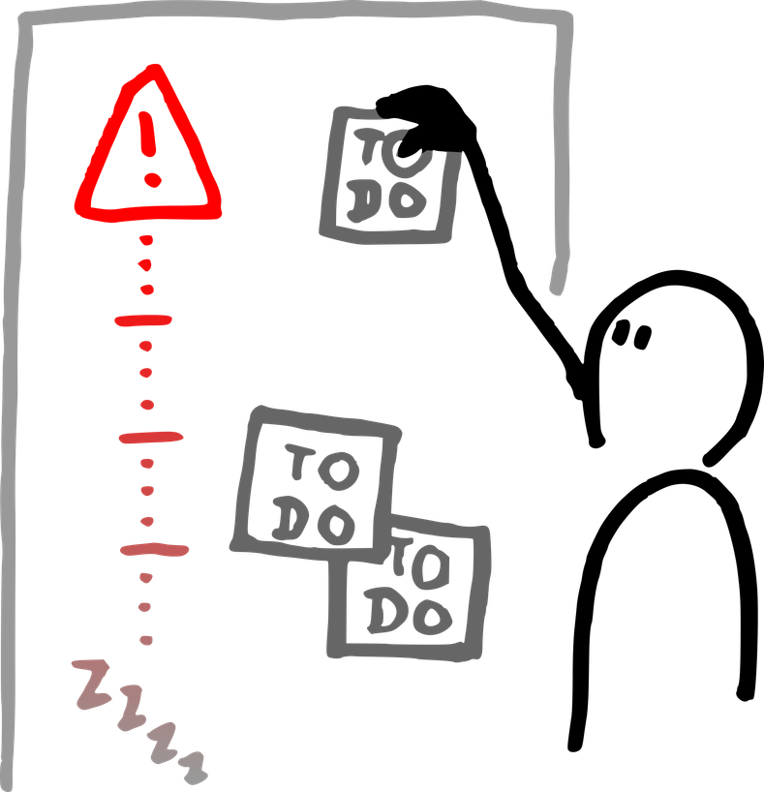
Introduction
Project Overview
Problem
How does sentence memorability depend on sentence structure (active vs passive) and the memorability of constituent words (high vs low memorability nouns)?
Solution
Experimentors designed a continuous recognition memory experiment using simple Subject–Verb–Object (S–V–O) sentences.
Sentences were systematically created using high- and low-memorability nouns, producing four sentence types:
HH (High–High) - HVH
HL (High–Low) - HVL
LH (Low–High) - LVH
LL (Low–Low) - LVL
Each sentence was presented in active and passive voice, allowing experimentors to examine how sentence structure and word memorability influence recognition performance.
1

Slide 3
Literature Overview
Noun-Level Memorability Norms-Paivio et al. (1968) established that concrete, high-imagery nouns are inherently more memorable. We directly operationalise this by sampling H and L nouns from established norms to build our stimulus set
Sentence Recognition Paradigm-Perfetti & Garson (1973) validated continuous recognition as a sensitive measure of sentence-level memory and showed active/passive confusion rates — directly motivating our 8-condition (4 word-types × 2 voices) design.
Additive Noun Effects in Context- Paivio & Foth (1970) demonstrated that imagery advantages generalise beyond single words into multi-word units, supporting the prediction that both subject and object memorability independently influence sentence recognition.

Slide 4
Experimental Setting
Location & Environment
Participants completed the experiment online, using their own laptops in a quiet, disturbance-free setting with a keyboard.
Participant Recruitment
Participants were recruited from BRSM-S26 course and were given appropriate credit for activity completion.
Procedure
Practice Phase:
Each participant first completed a set of practice trials to familiarize themselves with the task. Only after demonstrating satisfactory performance in the practice phase were they allowed to proceed to the main experiment.
Main Experiment:
The main experiment consisted of 3 blocks (sets) of trials. In each block, participants responded to target sentences.
Participants were allowed to take arbitrary breaks between blocks, as indicated by the "Rest Phase started" events in the logs.
Material & Apparatus
The experiment was conducted using a custom-built website designed specifically for the study.
The website presented sentences to participants and recorded their responses (key presses and reaction times).
A total of 400 systematically generated sentences (varying in memorability and voice: active/passive) were used as stimuli.
Participants completed the experiment on their own laptops or desktops, using a keyboard for responses.
All data (accuracy, reaction times, and validation checks) were automatically logged by the website for later analysis.
2

Slide 5
Variables in the Study
1
Independent Variables
Word memorability (HH, HL, LH, LL)
Sentence structure (Active / Passive)
Sentence type (HF, LVH, HVL, LVL)
2
Dependent Variables
Immediate recognition response (IR)
Verification response (WR)
Recognition accuracy
Reaction time (IR, WR)
3
Control Variables
Sentence repetition
Inter-stimulus interval (gap_time)
Validation trials
Block structure
4
Participant Variable
Participant ID
3

Slide 6
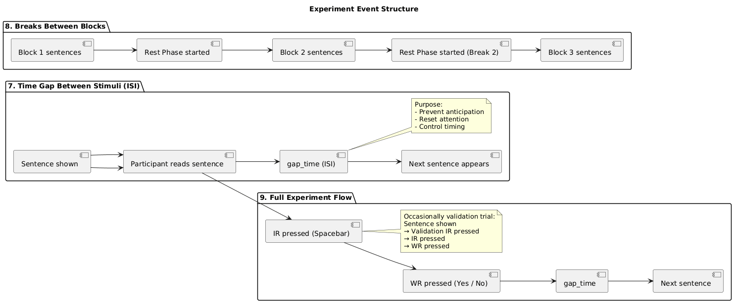
Experiment Event Structure
4

Slide 7
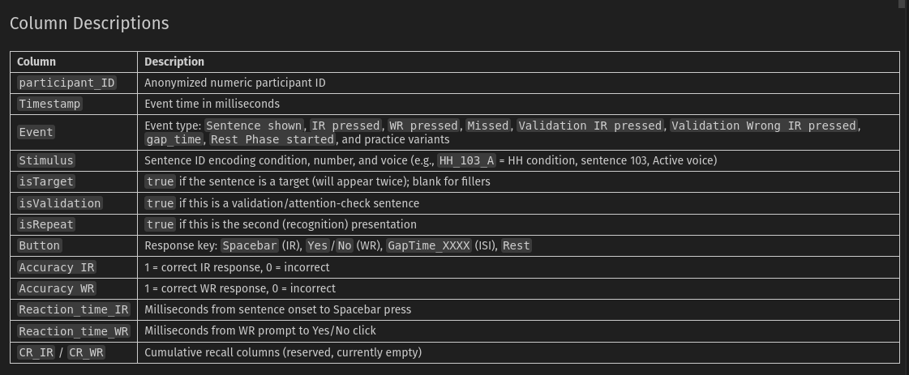
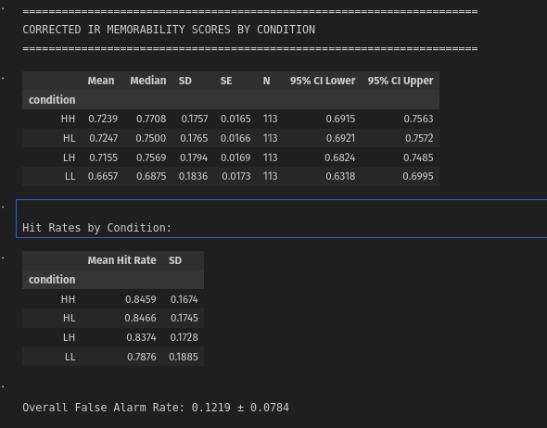
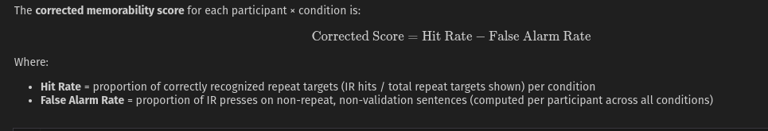
Descriptive Stats
Dataset Overview
Total number of participants - 114
Total Number of rows ~ 81,329
Rows excluding practice: 76,060
Stimulus prefix counts (all events)
HF : 29733
HH : 8589
HVL+HL : 7258
LVH : 5130
LVL : 5077
Exclusion Results
Excluded blocks - 10/342(2.9 %)
Fully excluded participants (all blocks failed): 1 Participants with ≥1 valid block: 113/114
Rows after exclusion: 73,503
5

Slide 8
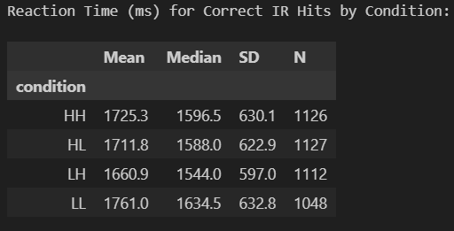
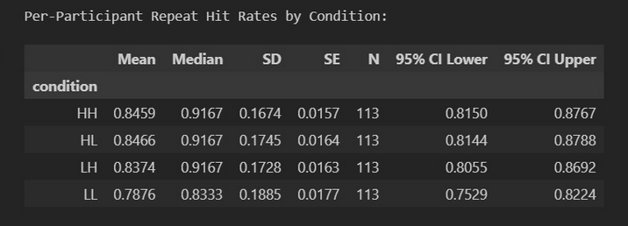
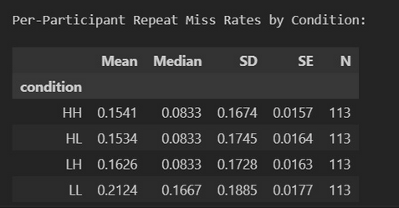
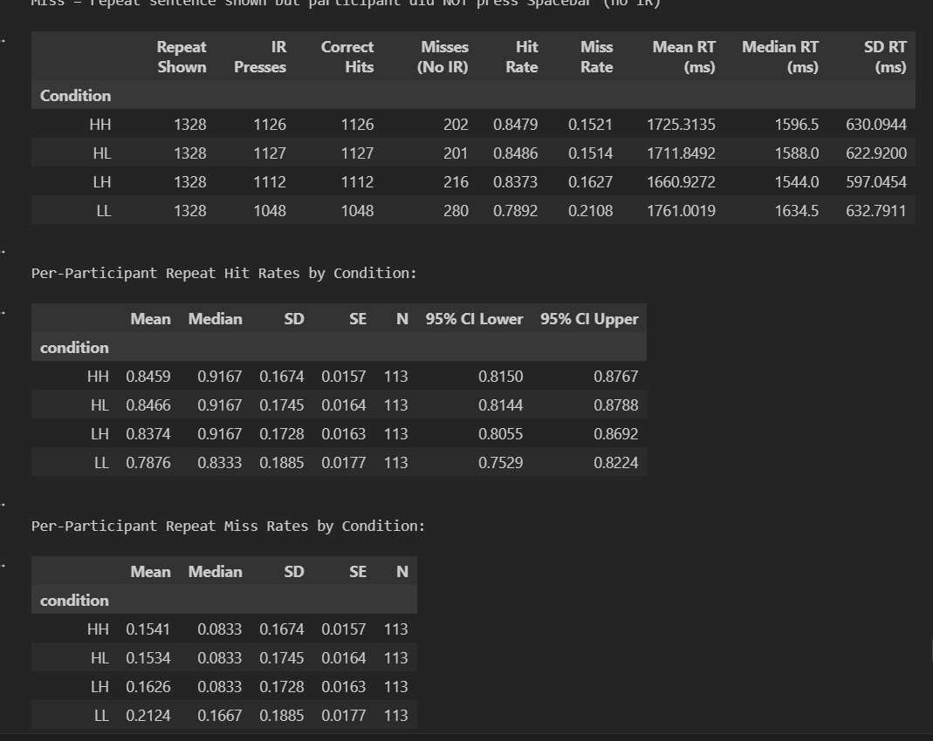
More Stats
is repeat stats
5

Slide 9
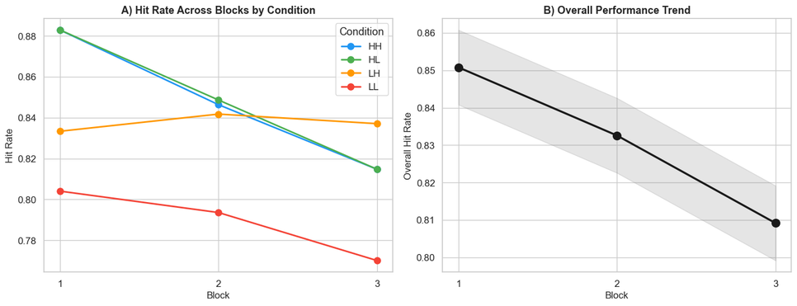
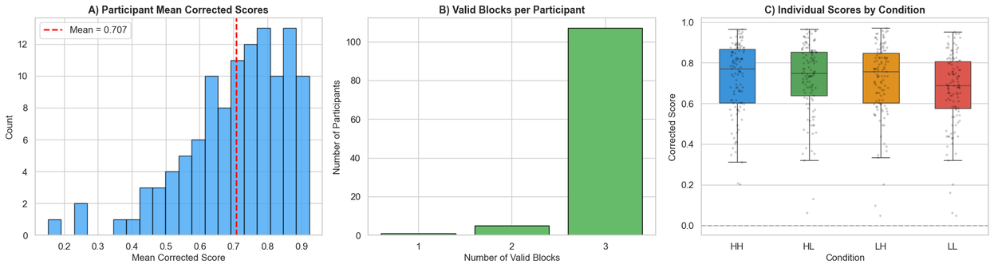
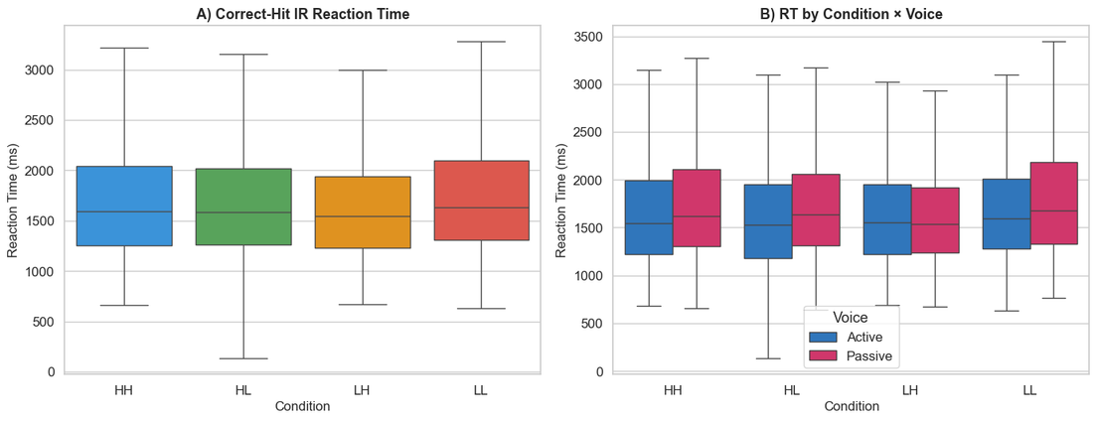
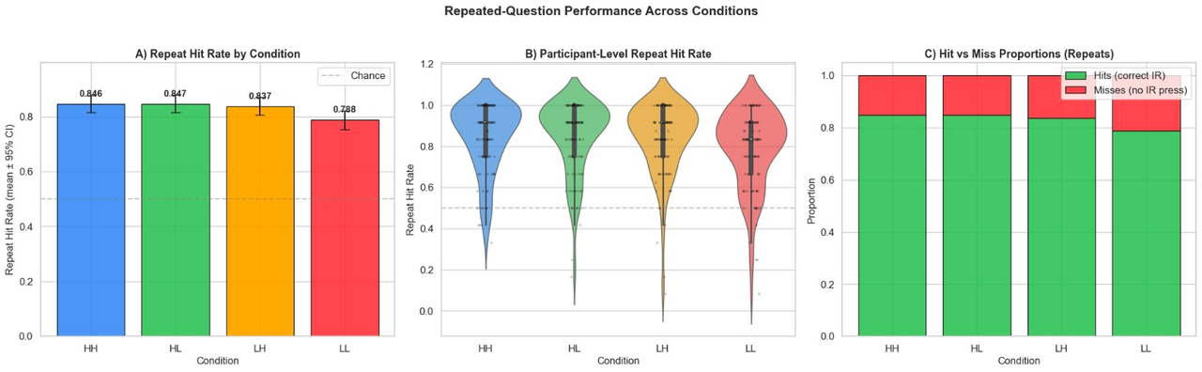
Data Visualizations
Multiple variables are present which can be visualized to understand the data properly.
Visualization based on the type of sentences given and the distribution of participants over valid blocks.
Participants performance across the blocks.
Graphs showing the results of Reaction Time and how it varies with different voices.
Distribution of Repeated Question wrt categories present.

Slide 10
Hypothesis Testing
We are testing the following Hypothesis
H1: Sentences with higher-memorability nouns (HH) will show higher corrected memorability scores than those with lower-memorability nouns (LL) with LH and HL in between them
H01:Null Hypothesis - There is correlation in memorability score based on availability of high memorability nouns in the sentences.
H2: Sentence voice (Active vs Passive) may modulate recognition memory performance
H02: Null Hypothesis :Sentence voice (Active vs Passive) does not modulate recognition memory performance

Slide 11
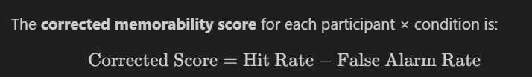
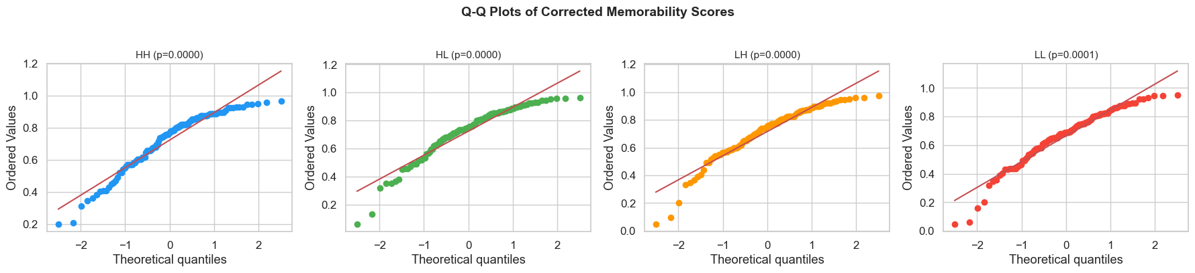
1. The Data & Distributions
Metric: Each participant produces a corrected memorability score (Hit Rate – False Alarm Rate) per condition.
Volume: 113 participants * 4 conditions (Each condition's spread of 113 scores forms our "distribution").
Goal: Test for normality (bell-shaped curve) to determine the appropriate statistical tests.
2. Normality Check (Shapiro-Wilk)
Result: All four conditions are significantly non-normal (all p < .001).
Shape: Distributions are left-skewed (a ceiling effect where most participants score high, leaving a long tail of lower scores).
Conclusion: All analyses use non-parametric tests (Kruskal-Wallis, Dunn's post-hoc with Bonferroni correction, and Mann-Whitney U).

Slide 12
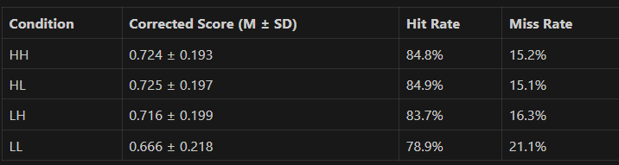

H1 HYPOTHESIS
KRUSKAL-WALLIS: H(3) = 10.00, P = .019, ΗH2ΗH2​ = 0.016
P <0.05 - SUGGESTS H1 IS RELEVANT (REJECT NULL HYPOTHESIS)

Slide 13
H2 HYPOTHESIS
Active: M = 0.702; Passive: M = 0.713
Mann-Whitney U: U = 6055.50, p = .504, r = 0.052
Not Supported — voice has no meaningful effect on
memorability
Mann-Whitney U tests whether Active vs. Passive voice sentences differ in memorability by comparing the ranks of their corrected scores — result: U = 6055.50, p = .504 → no significant difference
Condition × Voice interaction (exploratory)
Kruskal-Wallis (8 groups): H(7) = 14.03, p = .051
No evidence that voice differentially affects any noun-memorability condition
Verdict - Accept null hypothesis

Slide 14
Further works
Extend beyond H1 & H2:
H3: Sentence voice (Active vs Passive) affects memorability.
New hypotheses: Explore effects of reaction time, block order, and participant-level factors.
Apply more statistical analysis - Here dataset is mostly non parametric so we can apply non parametric tests.
Use non-parametric tests (Kruskal-Wallis, Mann-Whitney U, Dunn’s post-hoc) due to non-normal data.
Analyze reaction time differences across conditions and voices.
Investigate interaction effects (e.g., condition × voice).
More information about ranking could be found by doing pairwise bonferroni correction.
Perform block-level analysis for learning or fatigue effects.
Data Quality and Assumption Checks
Identify and handle outliers.
Check normality and variance assumptions.
Compare results with parametric tests (ANOVA) if assumptions are met (eg in case of RT have to be checked).
Apply different corrections techniques.
Look forward to more research papers and see if some new parameters related to memorablity has been used and try to apply if time permits.
9

Slide 15
TEAM P<1
The End

